Slide 1
Stable Coin Future
Bernard Parenteau
April 2021

Slide 2
What are Stable Coins?
Stable coins are digital assets (“cryptocurrencies”) whose value is pegged to an existing government-issued currency.
The issuer of the stable coin agrees to redeem any stable coins presented to them for the equivalent amount of local currency.
This allows users to move value, denominated in local currency, between digital asset exchanges and personal wallets.

Slide 3

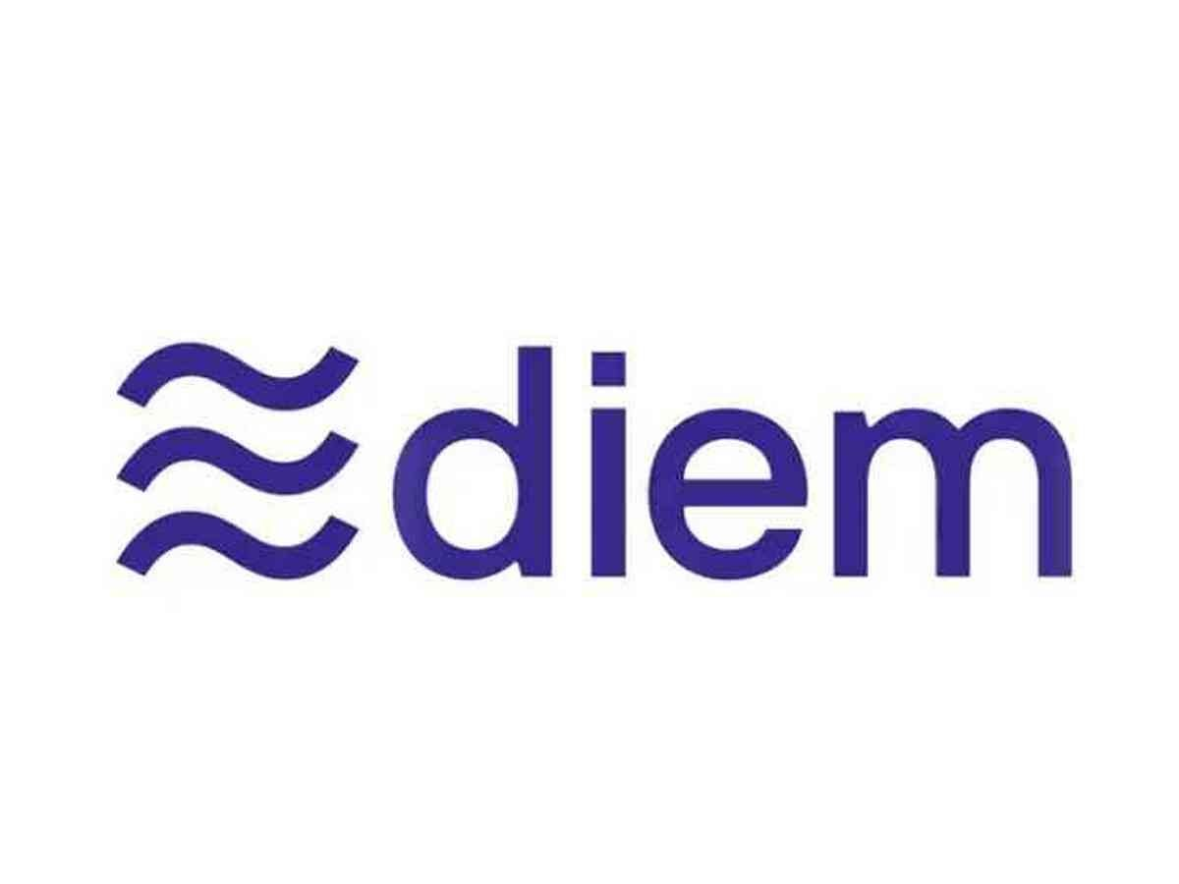

What are Stable Coins?
People may have heard of Tether (USDT), or Facebook’s Libra (which rebranded to Diem in December 2020)

Slide 4

Stable Value: USD
Most stable coins are backed by assets denominated in the currency to which the coin is pegged, frequently held in cash or highly liquid cash equivalents.
A few more thinly-traded stable coins are backed by cryptocurrency assets and maintain their pegs algorithmically.
Most stable coins issued to date have been pegged to the US dollar.

Slide 5
Stable Coin Uses
Although the use of stable coins up to the present has been primarily for trading on crypto-only exchanges, the ability to transfer stable coins between wallets potentially opens up substantial new uses.
For example, a user could transfer stable coins to the wallet of a merchant on checkout, similar to the use of a debit card.
Or a user in the US could send stable coins from their wallet to that of another user in the US or even to a user in another country almost immediately and essentially costlessly.

Slide 6
Stable Coin Growth
Stable coin issuance has grown dramatically very recently.
In 2018 alone a number of US dollar-pegged, asset-backed stable coins have been issued including
TrueUSD (TUSD),
USD Coin (USDC),
Paxos Standard Token (PAX),
Gemini Dollar (GUSD), and
StableUSD (USDS).
More have been issued since.

Slide 7
Bank Transfers
Why might stable coins become important?
Consider transactions in the current banking system;
debit and credit cards (expensive for merchants and takes days to receive funds),
domestic ACH (a day or two, less expensive than cards),
checks (days),
wires (expensive),
international transfers (expensive and slow)

Slide 8
Digital Currencies
Compare these to a method that has the ability to transfer value person-to-person or person-to-business anywhere almost immediately at very low cost.
Cryptocurrencies can do exactly that: transfer value person-to-person almost immediately, at very low cost, anywhere
And with a fixed value, stable coins remove the risk of volatility

Slide 9
Anonymity
For most cryptocurrencies, no information about the owner of an address is kept anywhere.
Possession of the keys is all that is required to control the coins sent to an address.
This anonymity feature is particularly contentious with many governments as well as with organizations like the FATF, the Financial Action Task Force, an international anti-money laundering organization
Stable coins designed by governments or with government approval in mind are likely to have identity features.

Slide 10
Blockchain Uses
Blockchains are effective in situations where there is no central authority and there is less than full trust between the participants.
Cryptocurrencies are the initial and obvious application.
There are a number of other areas of potential use including supply chains, financial asset trading, identity and credentials.
Most current stable coins use blockchains, though this may not be the case for stable coins issued or approved by governments.

Slide 11
Stable Coin Blockchains
A number of stable coins have been issued on the Ethereum blockchain, and some of these also have versions running on other blockchains such as EOS, Tron, Stellar, Binance chain, and others, including the Bitcoin network.
Most of these stable coins use the ERC-20 specification as a basis for their smart contracts on the Ethereum network.

Slide 12
Cryptocurrency Hindrances
So given that cryptocurrencies can transfer value person-to-person almost immediately at very low cost, anywhere, why aren’t cryptocurrencies used more?
The major hindrances include;
value fluctuation (distrust),
lack of wide acceptance (this is changing),
technical and usability barriers
What if these could be overcome with a constant auditable value, wider acceptance, and ease of use?

Slide 13
Hurdles Overcome?
Stable coins have the promise to overcome some of these major hurdles.
By having a value backed by the currency to which it’s pegged, the value fluctuation issue is addressed.
If issued or supported by an entity with guaranteed wide acceptance, another of the major issues is addressed.
The remaining major issue is perhaps UX/UI, which can be addressed.

Slide 14
Stable Coin History
Stable coins have recently become an area of great interest, but they have been around for more than a few years.
Until recently, the backing has not always been reliably backed by auditable assets.

Slide 15
Tether USDT
The first widely distributed stable coin was Tether (USDT), issued by a company of the same name, with common ownership to crypto-exchange Bitfinex.
It was first issued in 2015. Over time USDT proved extremely popular, especially for allowing crypto-only exchanges to have a proxy for the US dollar. It has become the most widely traded cryptocurrency since April 2019, surpassing Bitcoin.
However both Bitfinex and Tether have been dogged with financial questions, in the case of USDT as to whether it was properly backed by USD as it claimed.

Slide 16
Tether
In March of 2021 Tether released an auditor’s assurance letter that affirmed that their assets exceeded the liabilities represented by the total Tether tokens released (>$35B)*
Tether tokens are issued on both the Bitcoin and Ethereum blockchains.
For the Bitcoin blockchain, the Omni protocol layer is used which embeds additional information in the transaction’s return code.
For the Ethereum blockchain, the ERC-20 standard is used.
*
https://tether.to/wp-content/uploads/2021/03/tether-assurance-feb-2021.pdf

Slide 17
Tether
Tether has also issued its USDT coin on the Tron network, the EOS network, the Liquid network and others, albeit in smaller quantities.
Tether also has issued a Euro stable coin on both the Bitcoin and Ethereum blockchains.
In late 2019 Tether launched a Chinese Yuan pegged stable coin on the Ethereum blockchain.
In early 2020 Tether also launched a stable coin pegged to gold

Slide 18
TrustToken TUSD
TrustToken created a platform, procedures, and contracts to tokenize real-world assets to be held in escrow and governed by smart contracts.
In March 2018 TrustToken issued a tokenized US dollar stable coin called TrueUSD, symbol TUSD, that became available on the Bittrex exchange.
TrustToken is based on the ERC-20 standard on Ethereum.
To buy or redeem TrueUSD directly from TrustToken requires KYC (“Know Your Customer” banking requirements).

Slide 19


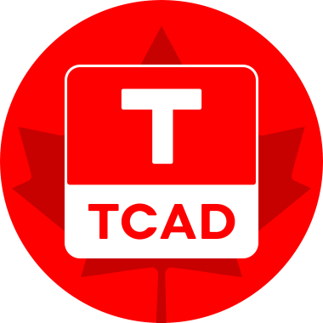

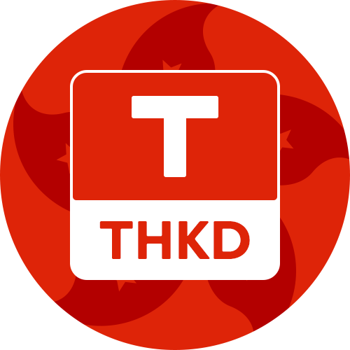
TrustToken
In April 2019 TrustToken also created fully-backed TrueGBP for British Pounds and since has issued TrueAUD for Australian Dollars, TrueCAD for Canadian Dollars and TrueHKD for Hong Kong Dollars. TrueSGD for Singapore dollars and TrueEUR were previously announced but are not currently supported.

Slide 20

Stably USDS
Seattle-based Stably created stable coin StableUSD, USDS.
USDS was first issued and supported by Bittrex in Dec. 2018.
It is an ERC-20 token on the Ethereum blockchain, and also has a version on the Binance chain using the BEP-2 standard.
Stably is also working with various other networks and projects including DigitalBits, Adamant, and FamaCash
Both USDS and TUSD are audited by Cohen & Company and escrowed by Prime Trust LLC and allow users to verify escrow.

Slide 21

Gemini GUSD
Gemini is one of the largest and highest profile crypto-currency exchanges in the US.
It is headquartered in New York and has followed that state’s most rigorous regulatory regime.
It was founded by the Winklevoss twins
(Harvard, Facebook).

Slide 22

Gemini GUSD
In September of 2018 Gemini issued stable coin GUSD pegged to the US dollar, which it refers to as the first regulated stable coin.
GUSD is issued on the Ethereum network and based on the ERC-20 standard

Slide 23

Paxos
Paxos also issued its USD-backed stable coin PAX on the Ethereum network in September 2018.
Like GUSD, PAX was approved by the New York Department of Financial Services with funds held in FDIC insured banks.
Also like GUSD, PAX uses the ERC-20 standard on the Ethereum blockchain.
Paxos refers to PAX as the most liquid regulated stable coin.
Paxos has also issued PAXG, a gold-backed stable coin.

Slide 24
Circle USDC
Circle was founded in 2013 to focus on cryptocurrency market opportunities and counts Goldman Sachs and mining giant Bitmain among its investors.
Together with Coinbase, Circle founded CENTRE with a very broad vision of asset backed stable coins, starting with US dollar-based USDC.

Slide 25

USDC, CENTRE
CENTRE is both an open consortium, in the sense that it invites additional members to join, and it is a suite of protocols, procedures, and smart contracts through which stable coins can be issued and backed.
USDC was launched in Oct. 2018 and the Ethereum blockchain
In June 2020 they announced issuance on the Algorand blockchain

Slide 26

Binance BUSD
Binance is one of the largest cryptcurrency exchanges in the world, and also has its own cryptocurrency (BNB) and blockchain (Bitcoin-like) on which that coin runs.

Slide 27

Binance BUSD
In September 2019, Binance announced issuance and NYDFS approval of its USD-pegged stable coin, Binance USD, with symbol BUSD, which it issued in conjunction with Paxos.
BUSD was issued as an ERC-20 based token on the Ethereum network, and in October was also issued on Binance’s blockchain.
In July 2019 Binance issued BGBP, pegged to the British Pound, which it discontinued in November 2020.

Slide 28

Stasis Euro
While most stable coins have been pegged to the USD, the Stasis Foundation (Isle of Man) and their subsidiary STSS (Malta) introduced Stasis Euro in 2018, and have at times indicated plans for other stable coins as well.

Slide 29
Algorithmic Stable Coins
There are also several stable coins that use algorithmic methods to stabilize the value, rather than being backed by the asset itself (e.g. USD).
BitUSD was the first notable stable coin being first issued in 2014 and trading on Bitshares network in 2015.
BitShares has also several other stable coins including BitCNY, BitEUR, BitBTC, BitGold and BitSilver, but trading in all pairs except BitCNY/BTS is very thin.
MakerDAO has also created a DAI stable coin for USD whose value is maintained algorithmically via somewhat complex rules governing collateral, via a smart contract on the Ethereum blockchain.

Slide 30
Libra/Diem
And then there is Diem, announced by Facebook as Libra on June 19, 2019, with expected launch in 2021.
Diem will be issued and controlled by the Switzerland-based Diem Association (formerly Libra Assoc.), of which Facebook is a member.
Libra was originally intended to be a stable coin pegged to a basket of currencies, for use in any country, and would run on Libra’s own network.
After the original announcement in 2019, it ran into substantial regulatory headwinds, in both the US and Europe. Subsequently a number of the original partners including Visa, MasterCard, PayPal, eBay, Stripe and other companies left the group over regulatory concerns

Slide 31
Libra
In October 2019 the FSB (Financial Stability Board) reported to the G20 the following (note; the Osaka meeting was June 2019)
G20 Leaders, in the Osaka Declaration, noted that crypto-assets do not pose a threat to global financial stability at this point, but that they remain vigilant to existing and emerging risks. However, the introduction of “global stablecoins” could pose a host of challenges to the regulatory community, not least because they have the potential to become systemically important, including through the substitution of domestic currencies. *
* https://www.fsb.org/wp-content/uploads/P131019.pdf

Slide 32
Libra
In October 2019 Facebook indicated that Libra could actually issue several stable coins pegged to government currencies rather than a single currency pegged to a basket.
In April 2020 Facebook released Libra specifications and announced Libra’s plans to issue a number of stable coins each pegged to a national currency, rather than a single coin pegged to a basket of currencies (though that remains a possibility).
The launch date was expected to be Q1 2021 and is still expected soon

Slide 33

Walmart
In early 2019 Walmart filed a patent application for a stable coin, using the US dollar in the application as description of how it might work.
Walmart and related stores and websites stores would represent immediate wide acceptance for a Walmart stable coin, similar to how Facebook would represent immediate and wide acceptance of Libra.
Recall that lack of wide acceptance is one of the factors that has hindered adoption of digital currencies.

Slide 34
Stable Coins and Banks
So why are authorities concerned about stable coins?
How might they impact the financial system?
What about banks?

Slide 35
What Banks Do
Banks take deposits from customers and use the proceeds to invest in assets and make loans to other customers.
In most countries they are highly regulated including the types and riskiness of the assets they can hold, as well as how much they can lend out versus the portion of deposits they must keep in reserve (the reserve ratio).
Banks perform several functions in the economy including allocation of capital from savers to more productive and profitable assets and borrowers.
They also implement the government’s monetary policy through their transmission of interest rates, as well as through the amounts of loans available.

Slide 36
Stable Coin Issuers
Stable coin issuance allows the issuers, especially exchanges, to effectively be banks, or more broadly to be financial services companies with advantages over banks.
Like banks, coin issuers take deposits in the form of users purchasing their stable coins, and then enable their depositors to spend those funds.
The issuers currently do not pay interest (though they could).

Slide 37
Stable Coin Issuers
Most stable coin issuers assure users that their stable coins are backed 100% by assets.
But in many cases those assets need not be cash.
In those cases, issuers can use the cash to purchase assets that generate income, provided that they have sufficient liquid assets to meet redemption requirements.
They will surely notice that as usage increases, net redemptions are actually negative.
Most cryptocurrency exchanges currently limit withdrawal amounts per period, which would greatly aid in managing reserves.

Slide 38
Stable Coin Issuer Advantages
In some ways, it means that the required minimum reserve ratio for stable coin issuers is 0%.
So they have advantages over banks of not paying interest on “deposits” for stable coins and in not having required cash reserves.
And they don’t have the physical, labor, or regulatory overhead that banks have.
Given the potential profitability, more entities including exchanges are likely to issue stable coins.
And exchanges may pool and lend fiat and stable coin balances.
Both are relatively straightforward.

Slide 39
Effects on Banks
The impact on existing traditional banks would be to decrease deposits as money moves from bank accounts to asset backed stable coins.
Many banks have recognized this and some are responding.
Japan’s Mizuho bank has developed a mobile wallet for customers and offers payment services with minimal fees for payments to merchants via the wallet.

Slide 40
Bank Projects
Mizuho Bank’s J-coin project includes dozens of banks and other financial companies and many local merchants.
It allows payments and transfers via mobile apps using QR codes.
Mizuho is currently discussing combining J-coin with other banks and card providers.
However it does not use a cryptocurrency or a blockchain.
JP Morgan announced the creation of its digital stable coin dubbed JPM Coin in early 2019.
The coin is issued from and redeemed to JP Morgan accounts, and trades on a permissioned Quorum blockchain run by JP Morgan.
There are plans to allow it to trade on other blockchains in the future.

Slide 41
Central Bank Digital Currency (CBDC)
Banking and commercial use of stable coins is just part of the potential impact.
Stable coins are effectively CBDCs without the Central Bank.
If their use grows dramatically it could have major implications on monetary policy which is controlled by central banks primarily through interest rates.
It could also have implications for the world’s financial system which is controlled in large part by the US and US dollar.

Slide 42
CBDC Potential
Central banks have recognized that there might be an opportunity to apply cryptocurrency technology to national currencies.
And if properly applied, a secure ledger of all transactions could provide unprecedented control and insight into the money supply as well as multiple other benefits to governments.
A number of central banks have been quite active in research on economic topics related to digital currencies.
Several limited trial projects have been run, and more are underway or planned.

Slide 43
CBDC Potential
The adoption of a secure, national cryptocurrency could provide a government with profound benefits on a number of levels.
Increased efficiency, manageability, and transparency in monetary policy
Superb insight and control for banking regulators
Increased financial inclusion for countries with substantial unbanked populations
Strong KYC/AML for financial transactions
Audit trails for controlled goods and substances
Insight into the economy for policy makers and researchers
Intelligence
Benefits to taxing authorities, and payers, particularly for VAT/sales with immediate collection
Efficient means of payments for benefits systems

Slide 44
CBDC Projects and Research
In the past few years, the International Monetary Fund, the Bank for International Settlements and the World Economic Forum have each published reports on central banks’ plans, research, and trials with national digital currencies.
The former details forms of “money”, the pros and cons of CBDCs, potential designs, and potential effects on existing banks.
The BIS paper summarizes the results of a survey of the world’s central banks and their plans and attitudes towards CBDC. Of the respondents, over 70% were involved or would soon be involved in CBCD research or plans.
The World Economic Forum paper was a report summarizing research, speeches and whitepapers related to CBDCs by central banks and others. It includes all blockchain (“DLT”) applications by governments, not only CBDCs.

Slide 45
Distributed Ledger Technology
In banking parlance, a cryptographically secured blockchain is usually referred to as Distributed Ledger Technology or DLT.
A number of central banks have conducted DLT tests or pilot programs for their domestic interbank settlement systems. Among these are the US Federal Reserve Bank of Boston and the Bank of Canada. Virtually all have found the system to work completely adequately and hold the promise of additional benefits.
Some of these central banks, including the Bank of Canada have continued with tests of securities settlement systems using DLT in conjunction with their stock exchange(s). And in June 2019 the Swiss stock exchange asked its central bank to issue a CBDC to facilitate clearing.

Slide 46
CBDC Projects
A few notable central banks, including those of Canada, England, and Sweden, have done extensive research on the subject of CBDCs and their economic effects.
A few central banks are actively working on issuing a CBDC for general use. These include the National Bank of Cambodia and the Eastern Caribbean Central Bank.

Slide 47
CBDC Projects
Virtually all of these projects have used open source, permissioned blockchains.
Most commonly used are
Corda (by R3),
Quorum (originally by JP Morgan),
Hyperledger Fabric (originally by IBM).
A couple have used a private implementation of a modified version of Ethereum.
Cambodia is using Hyperledger Iroha (originally by Soramitsu).

Slide 48
China
China’s central bank, the People’s Bank of China (PBoC) has been investigating digital currencies since early 2014.
In 2016 China wrote blockchain into their five year plan and in 2017 China opened the Digital Currency Research Institute (DCRI) with the plan to develop a digital currency.
In 2018 the PBoC confirmed that the bank was working on developing its own digital currency, and later said that the digital currency need not involve blockchain.

Slide 49
China
Due to scaling issues (reportedly over 92,000 transactions per second on Single’s Day) , China’s digital Renminbi is no longer expected to be blockchain-based.
It’s expected that the system will be on a private cloud managed by PBoC allowing PBoC to administer monetary policy.
It will also include a wallet client developed by PBoC that will be used by all participants and a verification center for identity information.
On October 24, 2019, Chinese President Xi Jinping extolled the virtues of blockchain technology and said China must seize the opportunity.
China’s digital currency launch is expected in 2020, likely very soon, though the official launch date has not been announced.

Slide 50
Conclusion
Stable coins have the potential to profoundly change banking and the provision of financial services.
Stable coin issuers and exchanges are the new banks. They’re just not recognized or regulated as such yet.
Central Bank Digital Currencies are coming.
Epilogue; The Irony of cryptocurrency technologies, developed and championed as anti-authoritarian and anti-big bank, becoming the ultimate tools of central banks and monetary authorities.

